Slide 1

PHY3209
THERMODYNAMICS
CHAPTER 3 PROPERTIES OF PURE SUBSTANCES
SEM 2 2017/2018

Slide 2
Objectives
Introduce the concept of a pure substance.
Discuss the physics of phase-change processes.
Illustrate the P-v, T-v, and P-T property diagrams and P-v-T surfaces of pure substances.
Demonstrate the procedures for determining thermodynamic properties of pure substances from tables of property data.
Describe the hypothetical substance “ideal gas” and the ideal-gas equation of state.
Apply the ideal-gas equation of state in the solution of typical problems.
Introduce the compressibility factor, which accounts for the deviation of real gases from ideal-gas behavior.
Present some of the best-known equations of state.

Slide 3
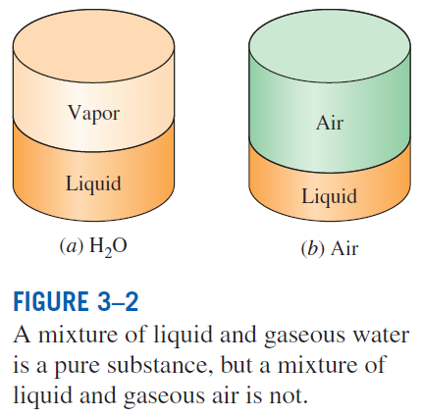
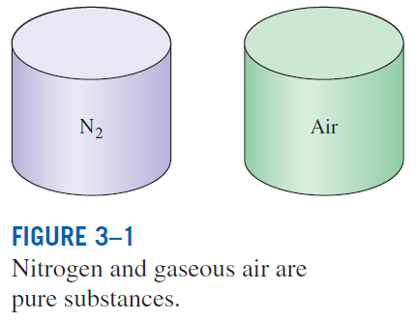
PURE SUBSTANCE
Pure substance: A substance that has a fixed chemical composition throughout.
Air is a mixture of several gases, but it is considered to be a pure substance.

Slide 4
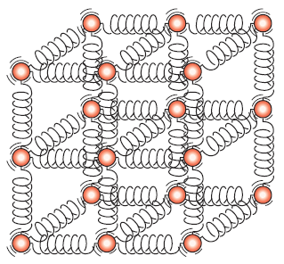
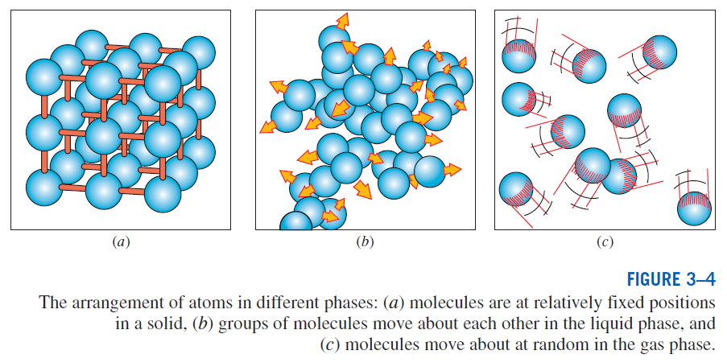
PHASES OF A PURE SUBSTANCE
The molecules in a solid are kept at their positions by the large springlike inter-molecular forces.
Phase –a distinct molecular arrangement that is homogenous

Slide 5
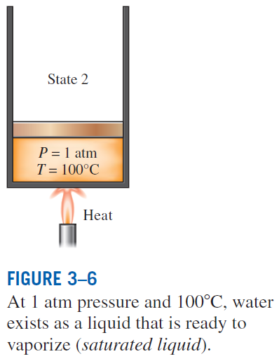
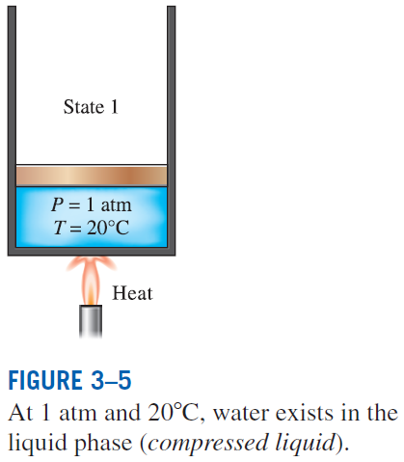
PHASE-CHANGE PROCESSES OF PURE SUBSTANCES
Compressed liquid (subcooled liquid): A substance that it is not about to vaporize
Saturated liquid: A liquid that is about to vaporize

Slide 6
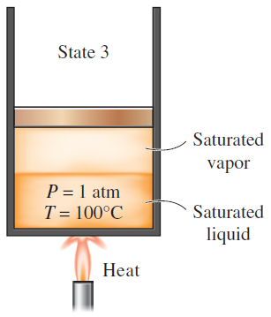
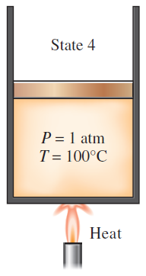
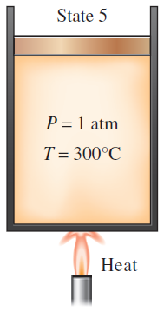
As more heat is transferred, part of the saturated liquid vaporizes (saturated liquid–vapor mixture).
At 1 atm pressure, the temperature remains constant at 100°C until the last drop of liquid is vaporized (saturated vapor).
As more heat is transferred, the temperature of the vapor starts to rise (superheated vapor).
Saturated vapor: A vapor that is about to condense.
Saturated liquid–vapor mixture: The state at which the liquid and vapor phases coexist in equilibrium.
Superheated vapor: A vapor that is not about to condense (i.e., not a saturated vapor).

Slide 7
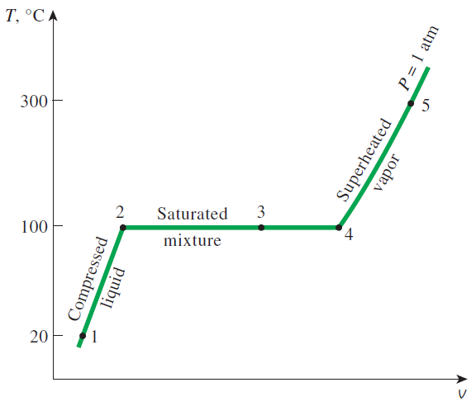
If the entire process between state 1 and 5 is reversed by cooling the water while maintaining the pressure at the same value, the water will go back to state 1, retracing the same path, and in so doing, the amount of heat released will exactly match the amount of heat added during the heating process.
T-v diagram for the heating process of water at constant pressure.

Slide 8
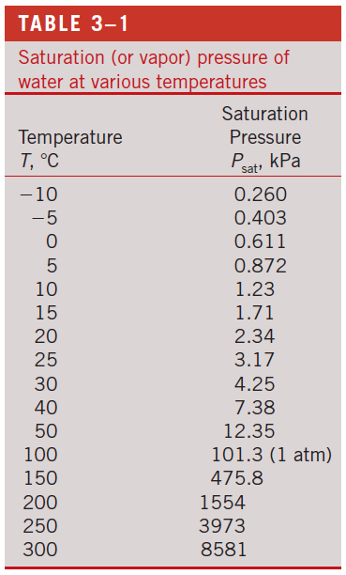
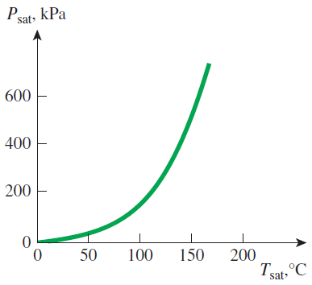
Saturation Temperature and Saturation Pressure
The temperature at which water starts boiling depends on the pressure; therefore, if the pressure is fixed, so is the boiling temperature.
Water boils at 100°C at 1 atm pressure.
Saturation temperature T_{sat}: The temperature at which a pure substance changes phase at a given pressure.
Saturation pressure P_{sat}: The pressure at which a pure substance changes phase at a given temperature.
The liquid–vapor saturation curve of a pure substance (numerical values are for water).

Slide 9
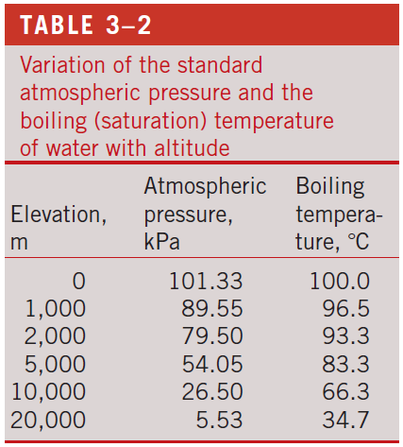
Latent heat: The amount of energy absorbed or released during a phase-change process.
Latent heat of fusion: The amount of energy absorbed during melting. It is equivalent to the amount of energy released during freezing.
Latent heat of vaporization: The amount of energy absorbed during vaporization and it is equivalent to the energy released during condensation.
The magnitudes of the latent heats depend on the temperature or pressure at which the phase change occurs.
At 1 atm pressure, the latent heat of fusion of water is 333.7 kJ/kg and the latent heat of vaporization is 2256.5 kJ/kg.
The atmospheric pressure, and thus the boiling temperature of water, decreases with elevation.

Slide 10
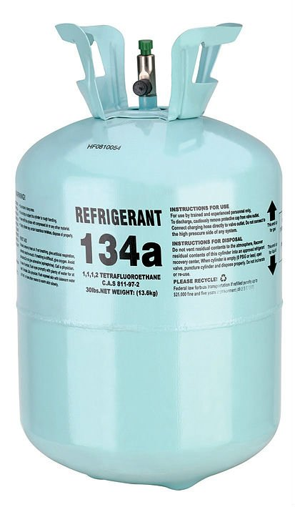
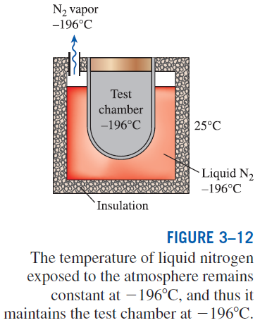
Some Consequences of T_{sat} and P_{sat} Dependence
Refrigerant 134a: Latent heat of
vaporization is 217 kJ/kg at 1 atm.
Vaporization at -26 deg

Slide 11
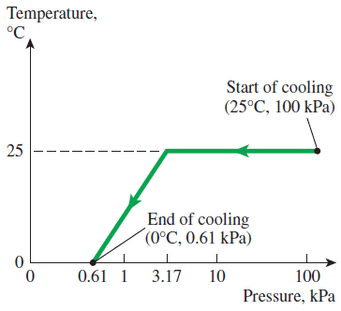
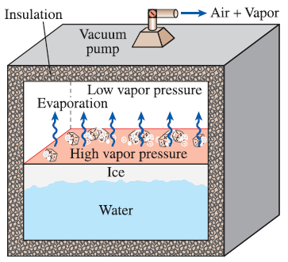
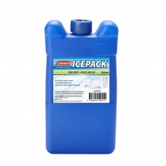
The variation of the temperature of fruits and vegetables with pressure during vacuum coolingfrom 25°C to 0°C.
In 1775, ice was made by evacuating the air space in a water tank.
Ice pack.

Slide 12
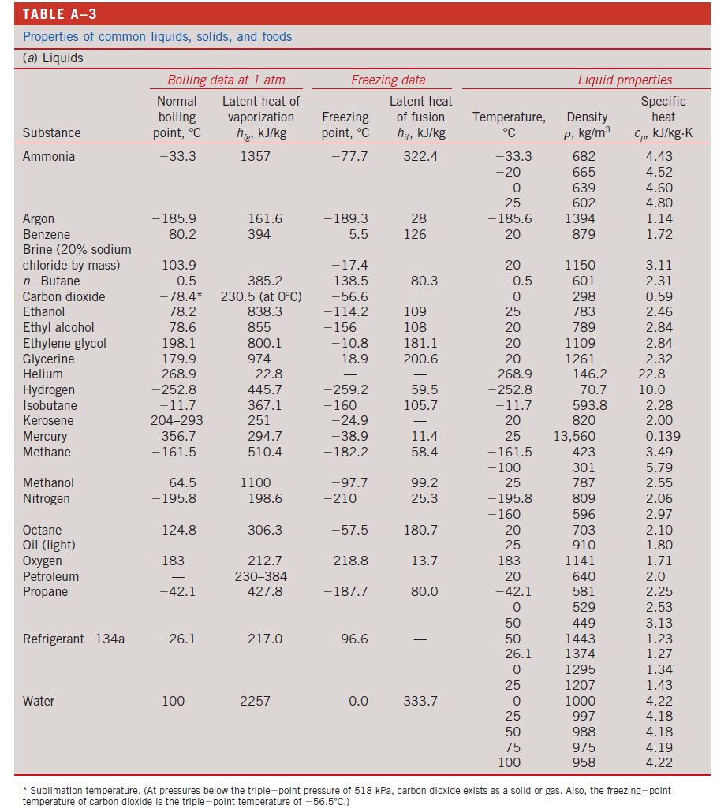

Slide 13
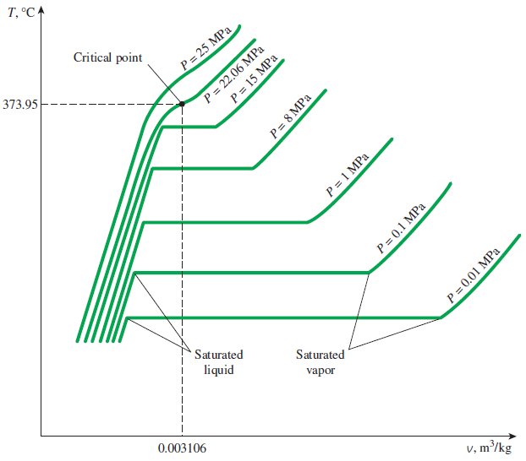
PROPERTY DIAGRAMS FOR PHASE-CHANGE PROCESSES
The variations of properties during phase-change processes are best studied and understood with the help of property diagrams such as the T-v, P-v, and P-T diagrams for pure substances.
Critical point: The point at which the saturated liquid and saturated vapor states are identical.
13
T-v diagram of constant-pressure phase-change processes of a pure substance at various pressures (numerical values are for water).

Slide 14
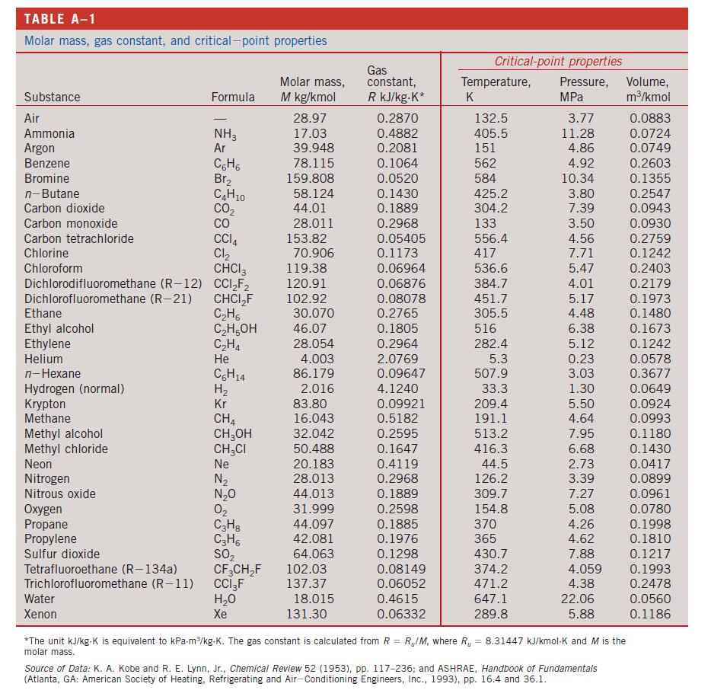

Slide 15
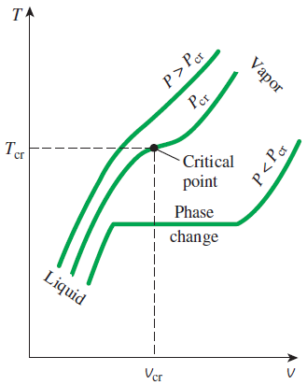
At supercritical pressures (P > P_{cr}), there is no distinct phase-change (boiling) process.
Specific volume of substance continually increases.
Substance at temp. above critical – superheated vapor
Substance at temp. below critical – compressed liquid
.

Slide 16
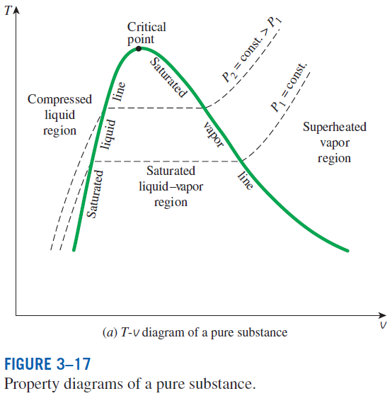
saturated liquid line
saturated vapor line
compressed liquid region (single phase liquid)
superheated vapor region (single phase vapor)
saturated liquid–vapor mixture region (wet region)- involved both phases

Slide 17
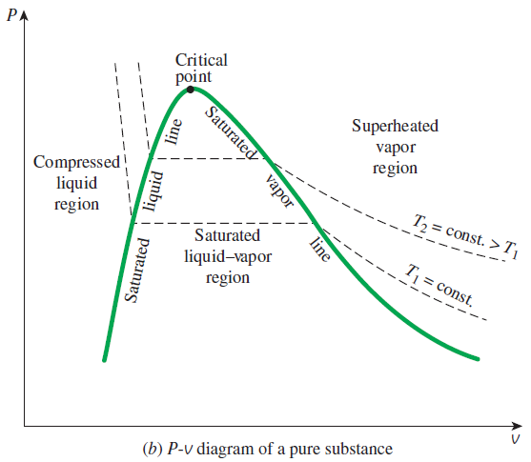
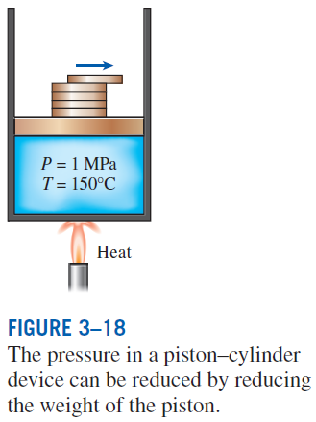

Slide 18
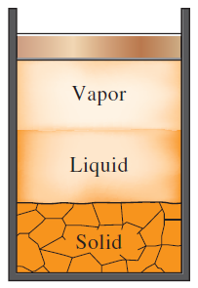
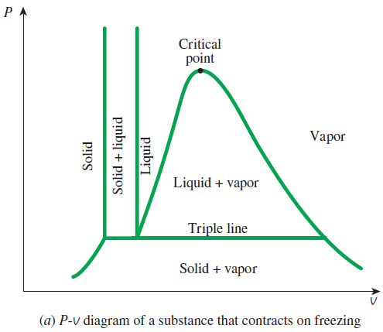
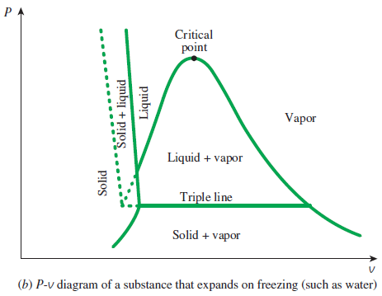
Extending the Diagrams to Include the Solid Phase
For water,
T_{tp} = 0.01°C
P_{tp} = 0.6117 kPa
At triple-point pressure and temperature, a substance exists in three phases in equilibrium.

Slide 19
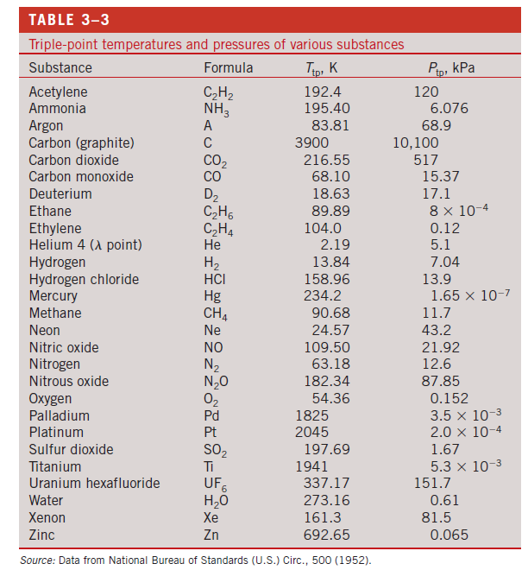

Slide 20
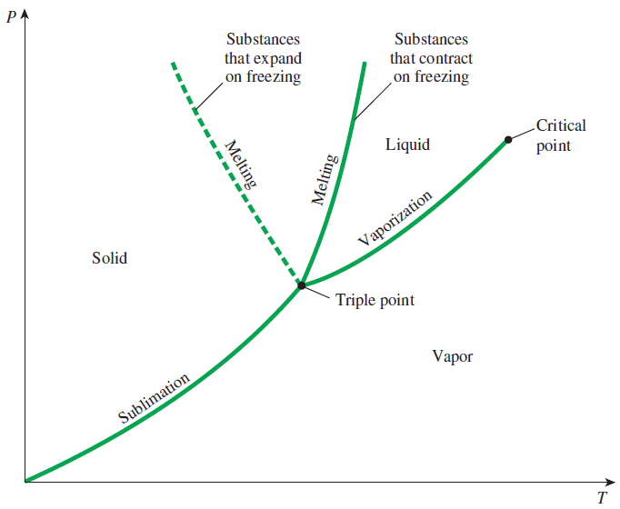
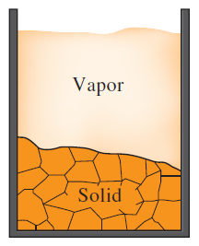
Phase Diagram
Sublimation: Passing from the solid phase directly into the vapor phase.
At low pressures (below the triple-point value), solids evaporate without melting first (sublimation).
P-T diagram of pure substances.

Slide 21
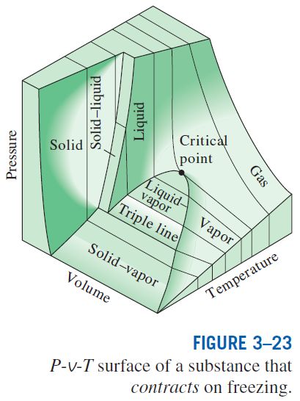
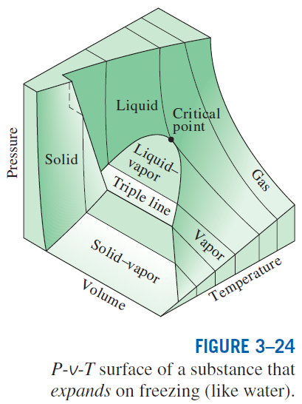
The P-v-T surfaces present a great deal of information at once, but in a thermodynamic analysis it is more convenient to work with two-dimensional diagrams, such as the P-v and T-v diagrams.

Slide 22
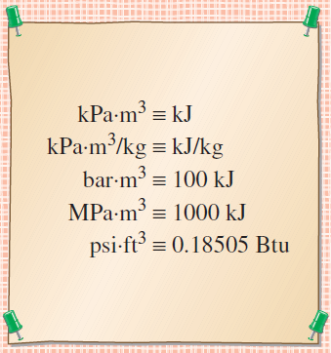
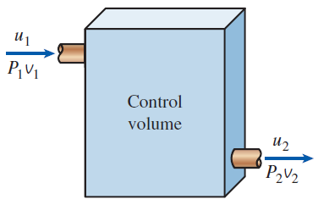
PROPERTY TABLES
For most substances, the relationships among thermodynamic properties are too complex to be expressed by simple equations.
Therefore, properties are frequently presented in the form of tables.
Some thermodynamic properties can be measured easily, but others cannot and are calculated by using the relations between them and measurable properties.
The results of these measurements and calculations are presented in tables in a convenient format.
Enthalpy—A Combination Property
The combination u + Pv is frequently encountered in the analysis of control volumes.
The product pressure × volume has energy units.

Slide 23
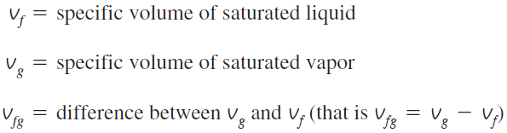
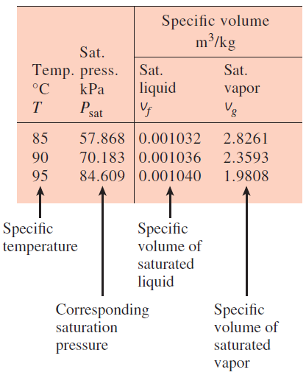
Saturated Liquid and Saturated Vapor States
A partial list of Table A–4.
Table A–4: Saturation properties of water under temperature.
Table A–5: Saturation properties of water under pressure.
Enthalpy of vaporization, h_{fg} (Latent heat of vaporization): The amount of energy needed to vaporize a unit mass of saturated liquid at a given temperature or pressure.

Slide 24
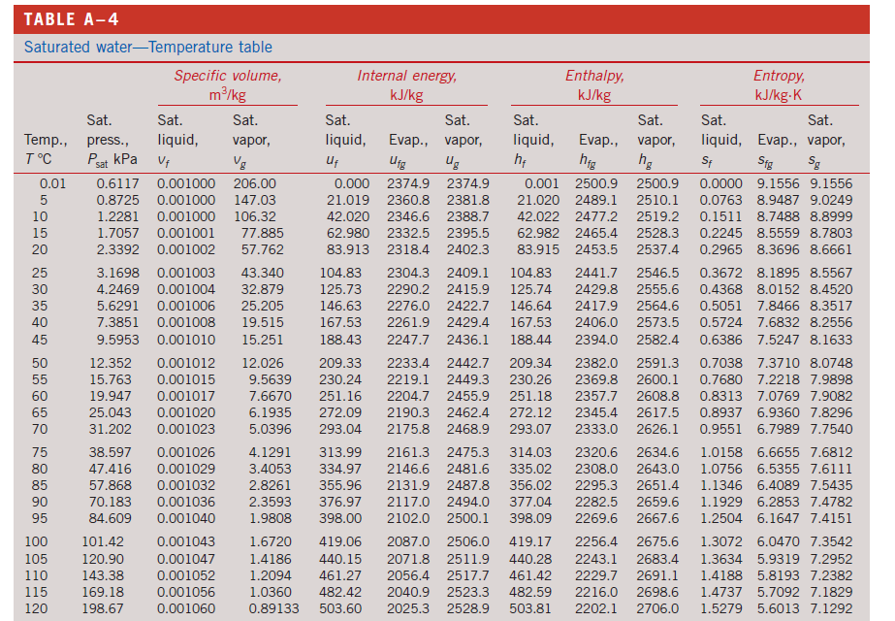

Slide 25
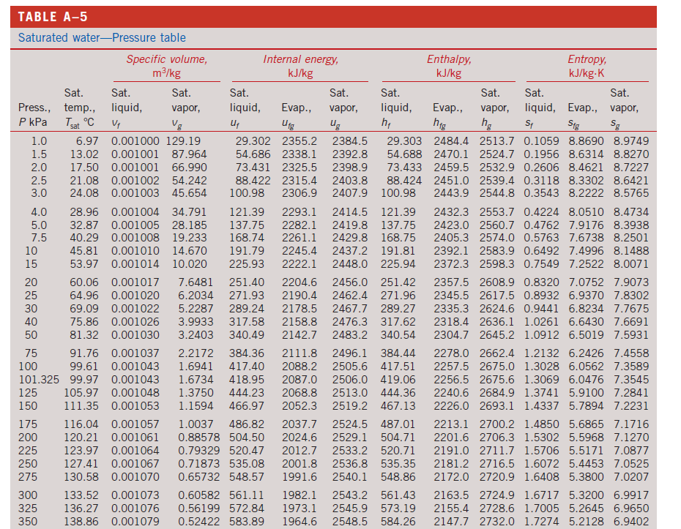

Slide 26
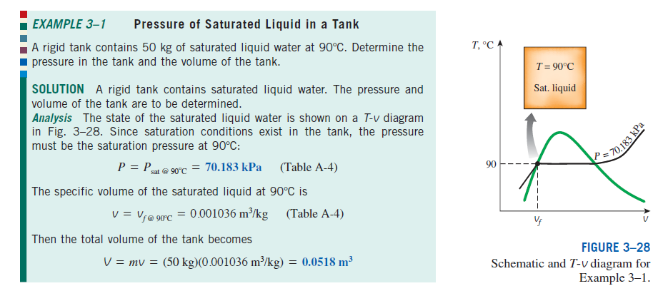

Slide 27
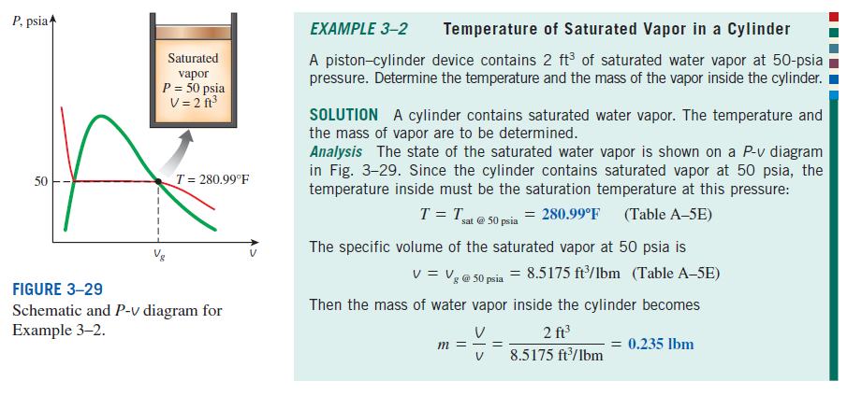

Slide 28
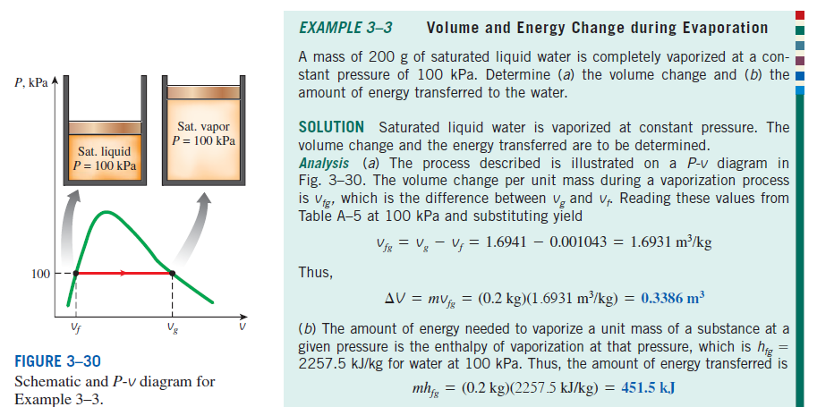

Slide 29
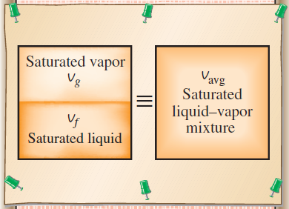
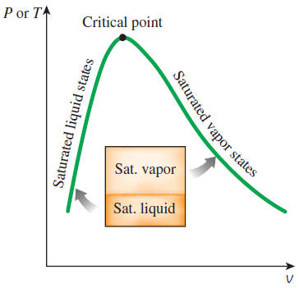
Saturated Liquid–Vapor Mixture
Quality, x : The ratio of the mass of vapor to the total mass of the mixture. Quality is between 0 and 1 0: sat. liquid, 1: sat. vapor.
The properties of the saturated liquid are the same whether it exists alone or in a mixture with saturated vapor.
Temperature and pressure are dependent properties for a mixture.
The relative amounts of liquid and vapor phases in a saturated mixture are specified by the quality x.
A two-phase system can be treated as a homogeneous mixture for convenience.

Slide 30
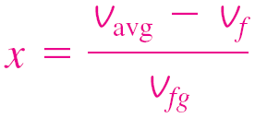
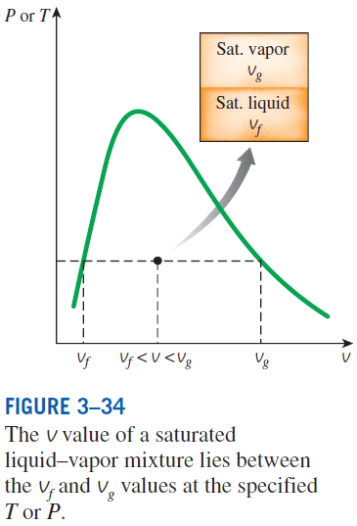
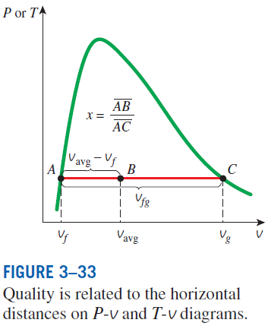
y v, u, or h.

Slide 31
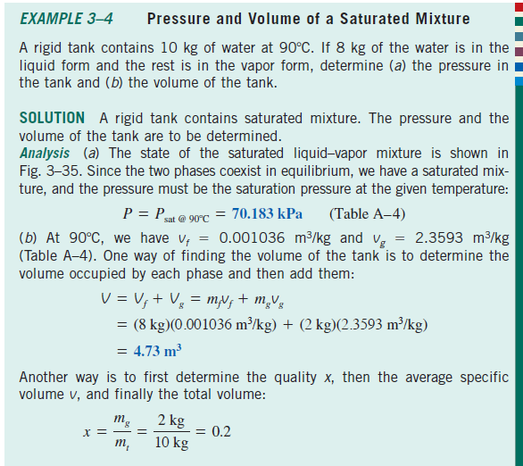
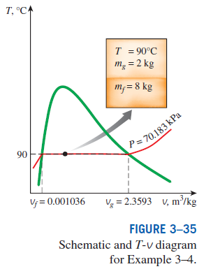
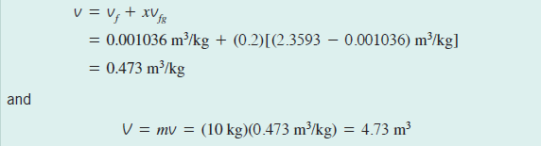

Slide 32




Slide 33


Slide 34

Superheated Vapor
In the region to the right of the saturated vapor line and at temperatures above the critical point temperature, a substance exists as superheated vapor.
In this region, temperature and pressure are independent properties.
Compared to saturated vapor, superheated vapor is characterized by
A partial listing of Table A–6.

Slide 35



Slide 36


Slide 37

Compressed Liquid
The compressed liquid properties depend on temperature much more strongly than they do on pressure.
Compressed liquid is characterized by
y → v, u, or h
A more accurate relation for h
A compressed liquid may be approximated as a saturated liquid at the given temperature.

Slide 38


Slide 39

Reference State and Reference Values
The values of u, h, and s cannot be measured directly, and they are calculated from measurable properties using the relations between properties.
However, those relations give the changes in properties, not the values of properties at specified states.
Therefore, we need to choose a convenient reference state and assign a value of zero for a convenient property or properties at that state.
The reference state for water is 0.01°C and for R-134a is -40°C in tables.
Some properties may have negative values as a result of the reference state chosen.
Sometimes different tables list different values for some properties at the same state as a result of using a different reference state.
However, In thermodynamics we are concerned with the changes in properties, and the reference state chosen is of no consequence in calculations.

Slide 40




THE IDEAL-GAS EQUATION OF STATE
Equation of state: Any equation that relates the pressure, temperature, and specific volume of a substance.
The simplest and best-known equation of state for substances in the gas phase is the ideal-gas equation of state. This equation predicts the P-v-T behavior of a gas quite accurately within some properly selected region.
Ideal gas equation of state
R: gas constant
M: molar mass (kg/kmol)
R_{u}: universal gas constant
Different substances have different gas constants.

Slide 41


Mass = Molar mass × Mole number
Ideal gas equation at two states for a fixed mass
Various expressions of ideal gas equation
Real gases behave as an ideal gas at low densities (i.e., low pressure, high temperature).

Slide 42



Slide 43



Is Water Vapor an Ideal Gas?
At pressures below 10 kPa, water vapor can be treated as an ideal gas, regardless of its temperature, with negligible error (less than 0.1 percent).
At higher pressures, however, the ideal gas assumption yields unacceptable errors, particularly in the vicinity of the critical point and the saturated vapor line.
In air-conditioning applications, the water vapor in the air can be treated as an ideal gas. Why?
In steam power plant applications, however, the pressures involved are usually very high; therefore, ideal-gas relations should not be used.

Slide 44




COMPRESSIBILITY FACTOR—A MEASURE OF DEVIATION FROM IDEAL-GAS BEHAVIOR
Compressibility factor Z A factor that accounts for the deviation of real gases from ideal-gas behavior at a given temperature and pressure.
The farther away Z is from unity, the more the gas deviates from ideal-gas behavior.
Gases behave as an ideal gas at low densities (i.e., low pressure, high temperature).
Question: What is the criteria for low pressure and high temperature?
Answer: The pressure or temperature of a gas is high or low relative to its critical temperature or pressure.

Slide 45



Reduced pressure
Reduced temperature
- Z factor for all gases – approx.
sameat the same reduced
pressure and temp. – principles of corresponding state.
Generalized compressibility chart (GCC) – results from curve fitting the data.
Observation from GCC
At very low pressure, gases behave as an ideal gas regardless of temperature
Comparison of Z factors for various gases.
3) Deviation is greates in the vicinity of critical point
2) At high temp., (T_{R} > 2), ideal gas behavior can be assumed with good accuracy
regardless of pressure (except for pressure >>1)

Slide 46




When P and v or T and v are given instead of P and T: Need to define extra reduced property called
Pseudo-reduced specific volume

Slide 47




Slide 48






Slide 49



Slide 50




OTHER EQUATIONS OF STATE
Several equations have been proposed to represent the P-v-T behavior of substances accurately over a larger region with no limitations.
Van der Waals Equation of State
Critical isotherm of a pure substance has an inflection point at the critical state.
This model includes two effects not considered in the ideal-gas model: the intermolecular attraction forces and the volume occupied by the molecules themselves. The accuracy of the van der Waals equation of state is often inadequate.

Slide 51



Beattie-Bridgeman Equation of State
The constants are given in Table 3–4 for various substances. It is known to be reasonably accurate for densities up to about 0.8ρ_{cr}.
Benedict-Webb-Rubin Equation of State
The constants are given in Table 3–4. This equation can handle substances at densities up to about 2.5 ρ_{cr}.
Virial Equation of State
The coefficients a(T), b(T), c(T), and so on, that are functions of temperature alone are called virial coefficients.

Slide 52



Slide 53



Slide 54



Slide 55



Slide 56




Slide 57
Summary
Pure substance
Phases of a pure substance
Phase-change processes of pure substances
Compressed liquid, Saturated liquid, Saturated vapor, Superheated vapor
Saturation temperature and Saturation pressure
Property diagrams for phase change processes
The T-v diagram, The P-v diagram, The P-T diagram, The P-v-T surface
Property tables
Enthalpy
Saturated liquid, saturated vapor, Saturated liquid vapor mixture, Superheated vapor, compressed liquid
Reference state and reference values
The ideal gas equation of state
Is water vapor an ideal gas?
Compressibility factor
Other equations of state
van der Waals Equation of State, Beattie-Bridgeman Equation of State
Benedict-Webb-Rubin Equation of State, Virial Equation of State

